Slide 1
Navigating Identity and Belonging: Young Adults from Mixed Serb-Hungarian Marriages in Serbia
Karolina Lendák-Kabók, PhD
Eötvös Loránd Univeristy, Budapet, Hungary
ECMI Workshop, Flensburg
December 12, 2023

Slide 2
Young people’s identity building
In the realm of social sciences, the identity formation of intermarriage-born young people has emerged as a significant area of study.
Researchers like Smith and Jones (2020) have noted that these individuals often experience a unique identity-building process, navigating between the intersecting cultural narratives of their parents' distinct backgrounds.
Lee and Kim (2021) emphasize that this experience can lead to a more fluid and multifaceted sense of self, although it may also pose challenges in terms of societal acceptance and internal conflicts.
Moreover, Garcia (2019) highlights the role of external factors such as community and societal attitudes, which can significantly influence these young people's identity formation.
These studies collectively suggest that while intermarriage-born individuals may face unique challenges, they also have the opportunity to develop a rich, complex understanding of identity that transcends traditional boundaries.

Slide 3
Methodology (1)
Part of my MSCA project – Intermarriage and Ethnic Identity (IMEI)
Vojvodina (northern province of Serbia)
Intermarriages between Serbs (majority) and three minority groups (Hungarians, Slovaks and Romanians)
These three minority gropus have the right for minority language education
Qantitative and Qualitative data collected
Qualitative:
Semi-structured interviews with couples who live in intermarriages (
Focus group discussions with young adults (only Hungarian – Serb intermarriage-born)

Slide 4
Methodology (2)
Focus gropus discussions were conducted in:
Novi Sad (majority Serb - city) – 6 participants (three grils, three boys)
Senta (majority Hungarian – smaller town) – 5 participants (three girls, two boys)
Questions:
Choice of name (Hungarian or Serbian)
Language of the schooling
Religion
Friends
Serb-Hungarian relations in Serbia
History
Anthem
Affections to Hungary
Sports
Books
Coded and analisyed in MAXQDA

Slide 5
Some preliminary results (Focus group -)
Novi Sad focus group - 4/6 parents were divorced
Friendships:
They can't make friends with Serbs because they don't understand the minority world, and Serbs never initiate friendship with them.
However, once they do make friends, they can count on their Serbian friends much more than the Hungarians (who shy away from problems).
Language:
What they also said is that they are bothered when they are "explained" on the street or lectured to speak Serbian.
Religion:
They have a great respect for the orthodox religion, celebrating all religious holidays with their extended family.
But on those occasions they have to be careful to speak Serbian with their brothers and sisters, because that is the expectation. Serb parents are very insistent that they attend religious celebrations - but sometimes it is difficult for them because they feel obliged to do so.

Slide 6
Some preliminary results (Focus group)
Anthem:
None of the six know the Hungarian national anthem, but they know and love Serbian.
They say it is the influence of the school, because they start every school celebration with the Serbian anthem and recently they have started the school year with the anthem.
Kin-state:
They don’t feel any connection to the Hungarian nation – when they visit Hungary. Some of them know Hungarian history, others don't - but they feel nothing when they visit Hungary and encounter historical symbols.
They are alienated from their Hungarian counterparts, they cannot identify with them, they do not think they understand their world or why they speak with an accent. It is their lack of acceptance that causes this aversion.

Slide 7
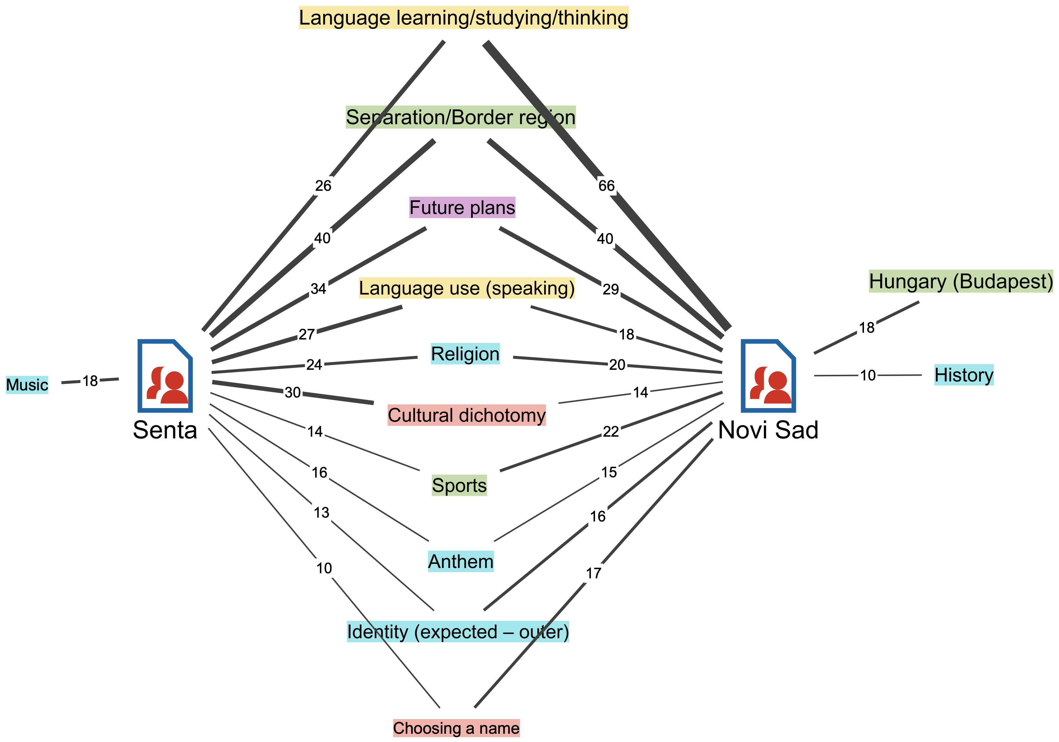

Slide 8
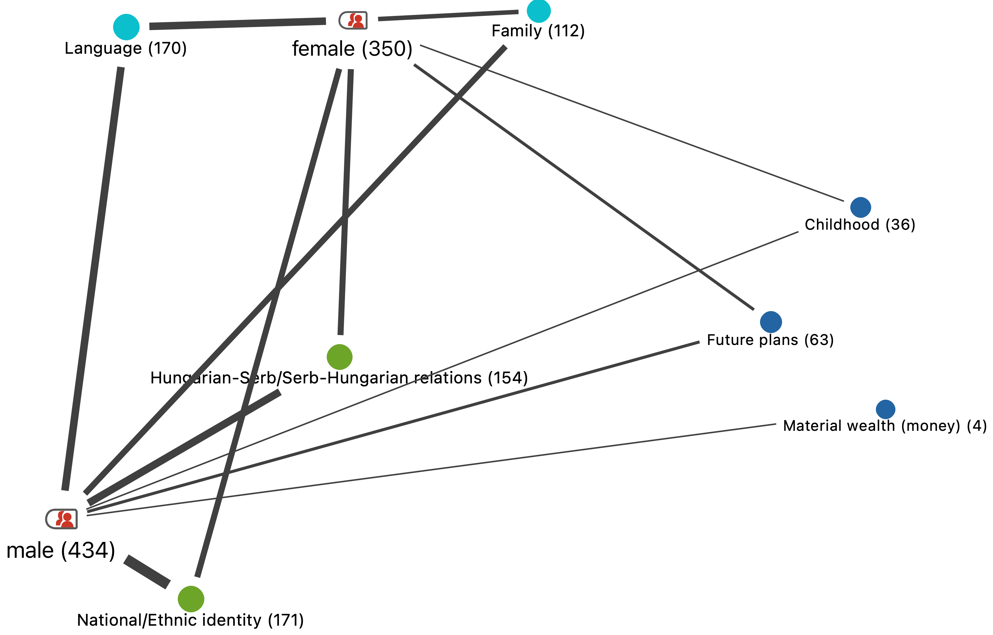

Slide 9
Conclusions – how does it fit in the EV?
Identity buidling is an important question – not talked about enough within national minorities – majorities relation
Mixed identity as a more prominent cathegory in the future?
After the brake-up of Yugoslavia – being mixed as a burden – it is time to talk about it again
Kin-state – nation state – minority community: triadic nexus

Slide 10
References
Smith, A., & Jones, B. (2020). Navigating Dual Identities: Intermarriage and Identity Formation. Journal of Cultural Studies, 45(2), 123-139.
Lee, C., & Kim, D. (2021). Multifaceted Identities: A Study on Children from Intermarriage Families. International Journal of Social Science Research, 34(1), 210-225.
Garcia, R. (2019). Community Influence on Intermarriage Born Youths' Identity. Sociology Today, 58(4), 400-416.

Slide 11
Thank you for your attention! Questions? ☺

